Slide 1
MySQL
Day 02
Introduction to MySQL and Important DDL Commands

Slide 2
Types of SQL Commands
Data Definition Language (DDL) :
MySQL Data Definition Language (DDL) commands are used to create, modify, and delete database objects such as tables, indexes, and views.
Data Manipulation Language (DML) :
Data Manipulation Language (DML) is a set of MySQL commands used to manipulate data in a database. DML commands are used to insert, update, and delete data in a table, as well as retrieve data using SELECT statements.
Data Control Language (DCL) :
MySQL DCL (Data Control Language) commands are used to manage user access to a database. DCL commands allow database administrators to create, modify, and remove users, and grant or revoke privileges to control access to the database.
Transaction Control Language (TCL) :
MySQL Transaction Control Language (TCL) commands are used to control transactions in a MySQL database. Transactions are a set of operations that are performed as a single unit of work. A transaction can contain one or more DML (Data Manipulation Language) commands such as INSERT, UPDATE, DELETE, and SELECT.

Slide 3
Common DDL Commands
CREATE: used to create databases & new objects in the database, such as tables, views, indexes, and stored procedures.
ALTER: This command is used to modify existing objects in the database.
DROP: This command is used to delete objects from the database.
TRUNCATE: This command is used to delete all the data in a table, but not the table structure itself.
RENAME: This command is used to rename a database object, such as a table or column.
COMMENT: This command is used to add comments to a database object, such as a table, column, or index.
CONSTRAINT: This command is used to enforce rules and restrictions on the data stored in a table, such as unique, primary key, and foreign key constraints.
INDEX: This command is used to create indexes on one or more columns of a table, which can speed up data retrieval.

Slide 4
Common Constraints
PRIMARY KEY: Used to uniquely identify each record in a table. A primary key column cannot contain null values, and each value must be unique.
FOREIGN KEY: Used to establish a relationship between two tables. The foreign key column in one table is linked to the primary key column in another table. This ensures that data entered into the foreign key column matches data in the primary key column.
UNIQUE: Ensures that the values in a column are unique, but allows null values.
NOT NULL: Ensures that a column cannot contain null values.
CHECK: Used to specify a condition that must be met for data to be entered into a column.
AUTO_INCREMENT: used to automatically generate a unique value for a column when a new row is inserted into a table. It is commonly used with the primary key column to ensure that each row has a unique identifier.
DEFAULT: Used to specify a default value for a column when a new row is inserted into a table, if no value is explicitly specified for that column. The DEFAULT constraint can be used with any data type in MySQL.

Slide 5
Referential Actions
Referential Actions in MySQL are used to define actions that should be taken when a row in a ‘parent table’ is updated or deleted, and there are rows in ‘child tables’ that reference the parent row.
There are 4 Referential actions that can be defined in MySQL
CASCADE: If a row in the parent table is updated or deleted, all related rows in the child table will also be updated or deleted, respectively.
SET NULL: If a row in the parent table is updated or deleted, all related rows in the child table will have their foreign key column(s) set to NULL.
RESTRICT: If a row in the parent table is updated or deleted, and there are related rows in the child table, the update or delete operation will be prevented.
NO ACTION: This is similar to RESTRICT, and is the default behavior if no referential action is specified.
Referential actions help to ensure data consistency and accuracy in the database by automatically updating or deleting related rows in child tables when a row in a parent table is updated or deleted.

Slide 6
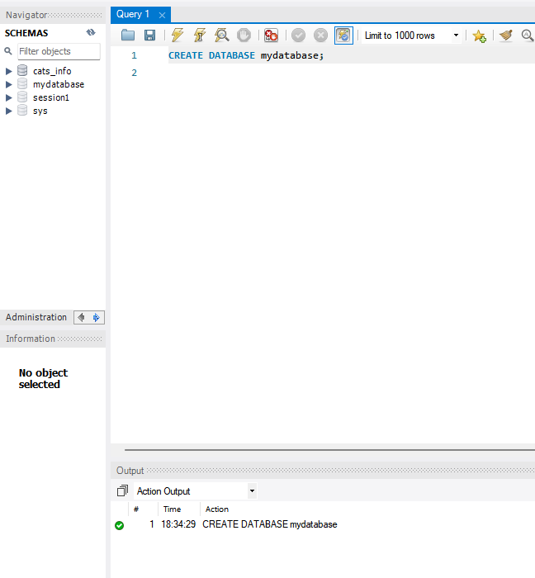
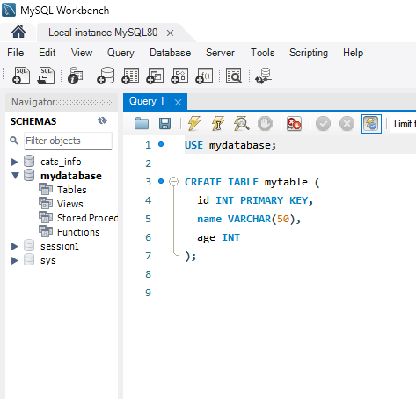
CREATE with related CONSTRAINTS
Creating a Database
Creating a Table
We use CREATE command to create a database and Table as well in MySQL.
In the right side image, We have created a new table called "mytable" within the "mydatabase" database. The table has three columns: "id", "name", and "age". The "id" column is defined as the primary key of the table, and will contain unique integer values. The "name" column is defined as a string with a maximum length of 50 characters, and the "age" column is defined as an integer.

Slide 7
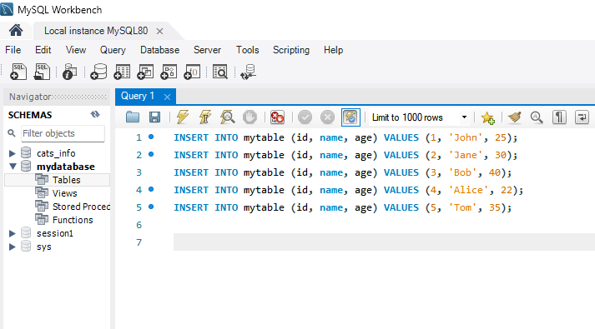
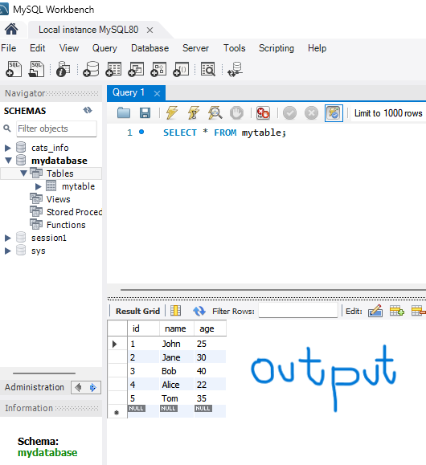
Inserting Values into table
Inserting Values into Table
The Table is Created!
We use INSERT command to populate table in our database. Note the Syntax.
Syntax is INSERT INTO <table_name> (col_1,col_2,col_3) VALUES (val_1,val_2,val_3);

Slide 8
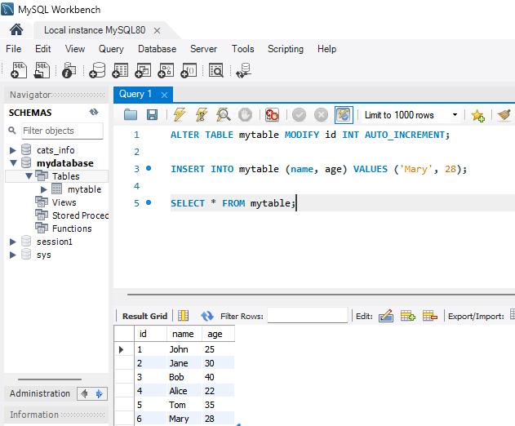
ALTER & AUTO_INCREMENT & related constraints
In this example, the "id" column is modified to be AUTO_INCREMENT, and the subsequent INSERT statement inserts a row with values for the "name" and "age" columns, but not for the "id" column. MySQL will automatically generate a unique value for the "id" column when the row is inserted.

Slide 9
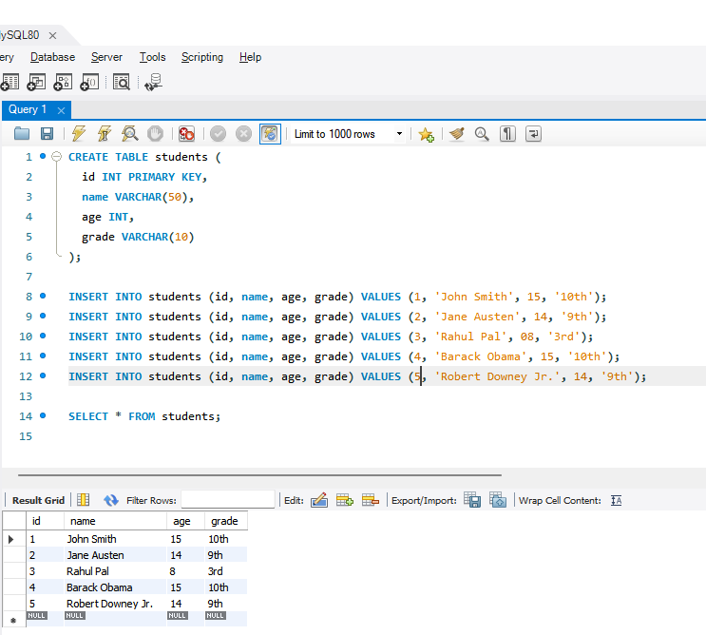
PRIMARY KEY
In this example, we've defined the "id" column as the primary key of the "students" table. The "id" column is of the integer data type, and will contain a unique value for each student.
Because the "id" column is the primary key, we must ensure that the "id" value is unique. If we try to insert a row with a duplicate "id" value, the INSERT statement will fail with an error.

Slide 10
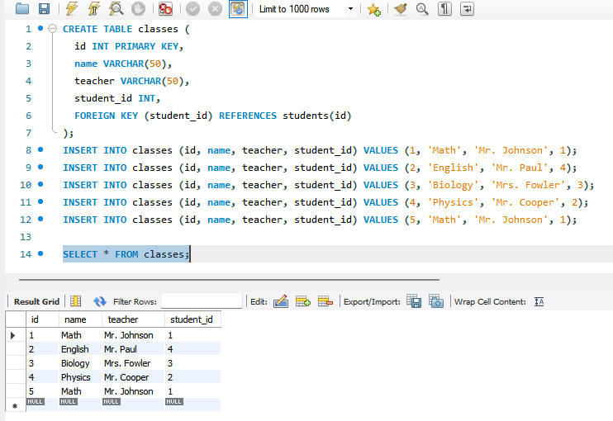
FOREIGN KEY
Keep in mind the previous slide that has ‘students’ table.
We create another table ‘classes’ having info about classes offered at school.
We have to associate each class with ‘students’ enrolled in it using FOREIGN KEY as above.
We have to make sure that we enter the values in the ‘classes’ table associated with the relevant ‘student_id’ in previous ‘student’ table, or else the INSERT statement will fail with an error.

Slide 11
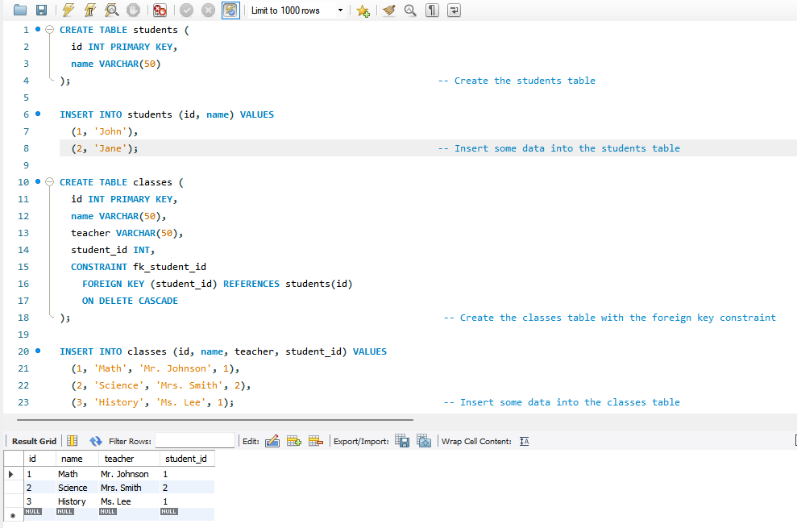
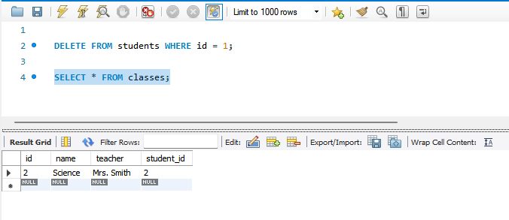
CASCADE
This is one example of CASCADE for understanding the concept.
We create a new ‘student’ & ‘classes’ tables with PRIMARY KEY & FOREIGN KEY. (left side image)
Now we try applying CASCADE on a ‘students’ table and a ‘classes’ table with an ‘ON DELETE CASCADE’ constraint on the ‘student_id’ foreign key column.
We then delete a row from ‘students table’ to verify the CASCADE constraint (right side image)
In the output, we can see that the corresponding rows in the ‘classes’ tables are also deleted, and the CASCADE constraint has worked perfectly.

Slide 12
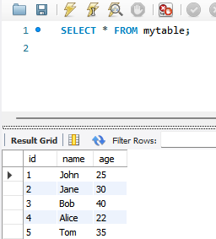
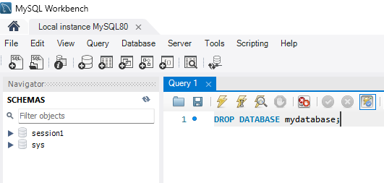
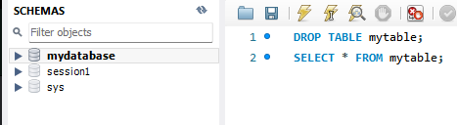

Here, We can see ‘mytable’ table in ‘mydatabase’ database.
DROP
Here, We Drop the Database, and Notice the SCHEMAS section, we no longer have the ‘mydatabase’ database
We used DROP command to delete ‘mytable’ table from the ‘mydatabase’ database (Notice the SCHEMAS section in the image*)
See the Action Output Section, After DROP TABLE command, the Table gets deleted and Workbench notifies that the Table doesn’t Exist after using SELECT command (Blue arrow in the image)

Slide 13
CONCLUSION
We have seen SOME of the most commonly used and Important DDL Commands used in MySQL.
In no way this is a comprehensive presentation, but it definitely refreshes the most important DDL concepts and commands that we may come across in our day-to-day working with MySQL in our Data Analysis endeavor.
In the Next presentation, we will Learn about most commonly used DML concepts.
Have a Nice Time!

